Slide 1
National Economic Education Delegation
Vision
  One day, the public discussion of policy issues will be grounded in an accurate perception of the underlying economic principles and data.
Mission
  NEED unites the skills and knowledge of a vast network of professional economists to promote understanding of the economics of policy issues in the United States.
NEED Presentations
  Are nonpartisan and intended to reflect the consensus of the economics profession.

Slide 2
Who Are We?
Honorary Board: 54 members
  2 Fed Chairs: Janet Yellen, Ben Bernanke
  6 Chairs Council of Economic Advisers
    Furman (D), Rosen (R), Bernanke (R), Yellen (D), Tyson (D), Goolsbee (D)
  3 Nobel Prize Winners
    Akerlof, Smith, Maskin
Delegates: 652+ members
  At all levels of academia and some in government service
  All have a Ph.D. in economics
  Crowdsource slide decks
  Give presentations
Global Partners: 48 Ph.D. Economists
  Aid in slide deck development

Slide 3


Where Are We?

Slide 4
Available NEED Topics Include:
US Economy
Healthcare Economics
Climate Change
Economic Inequality
Economic Mobility
Trade and Globalization
Minimum Wages
Immigration Economics
Housing Policy
Federal Budgets
Federal Debt
Black-White Wealth Gap
Autonomous Vehicles
US Social Policy

Slide 5
Cryptocurrencies & The Future of Money
Joan Nix,
Associate Professor of Economics
Queens College, CUNY
October 24, 2023

Slide 6
Submitting Questions
Raise your digital hand or submit questions in the chat.
  I will try to handle them as they come up.
We will do a verbal Q&A once the material has been presented.
Slides will be available from the NEED website tomorrow (https://needelegation.org/delivered_presentations.php)

Slide 7
Outline of the Talk
Fun Facts about Bitcoin
A little bit on the underlying technology of bitcoin.
Economist evaluation of 2 Key Questions
  Is Bitcoin serving a legitimate economic role?
  Is there potential for beneficial, financial innovations using the underlying technology?
But, in order to tap that potential, we need:
  Legislation to provide “good” regulation of crypto markets.
  The Federal Reserve needs to follow other central banks in creating a safe and secure, digital means of payment: Central Bank Digital Currency (CBDC)

Slide 8
But First, What is Bitcoin?
Bitcoin is the first cryptocurrency and was invented in 2008.
Cryptocurrencies are a form of digital money (viz. data on a computer) where account ownership is confidential and where record keeping is decentralized over a multitude of computers
More importantly,…

Slide 9
Bitcoin Has Started a Revolution in Finance
The way we buy and sell things, our “payments system;” the way we save, borrow and invest; the role of banks and other financial firms are rapidly changing.
In my view, Bitcoin will NOT be an important player in these developments, but the technologies underlying Bitcoin may be.

Slide 10
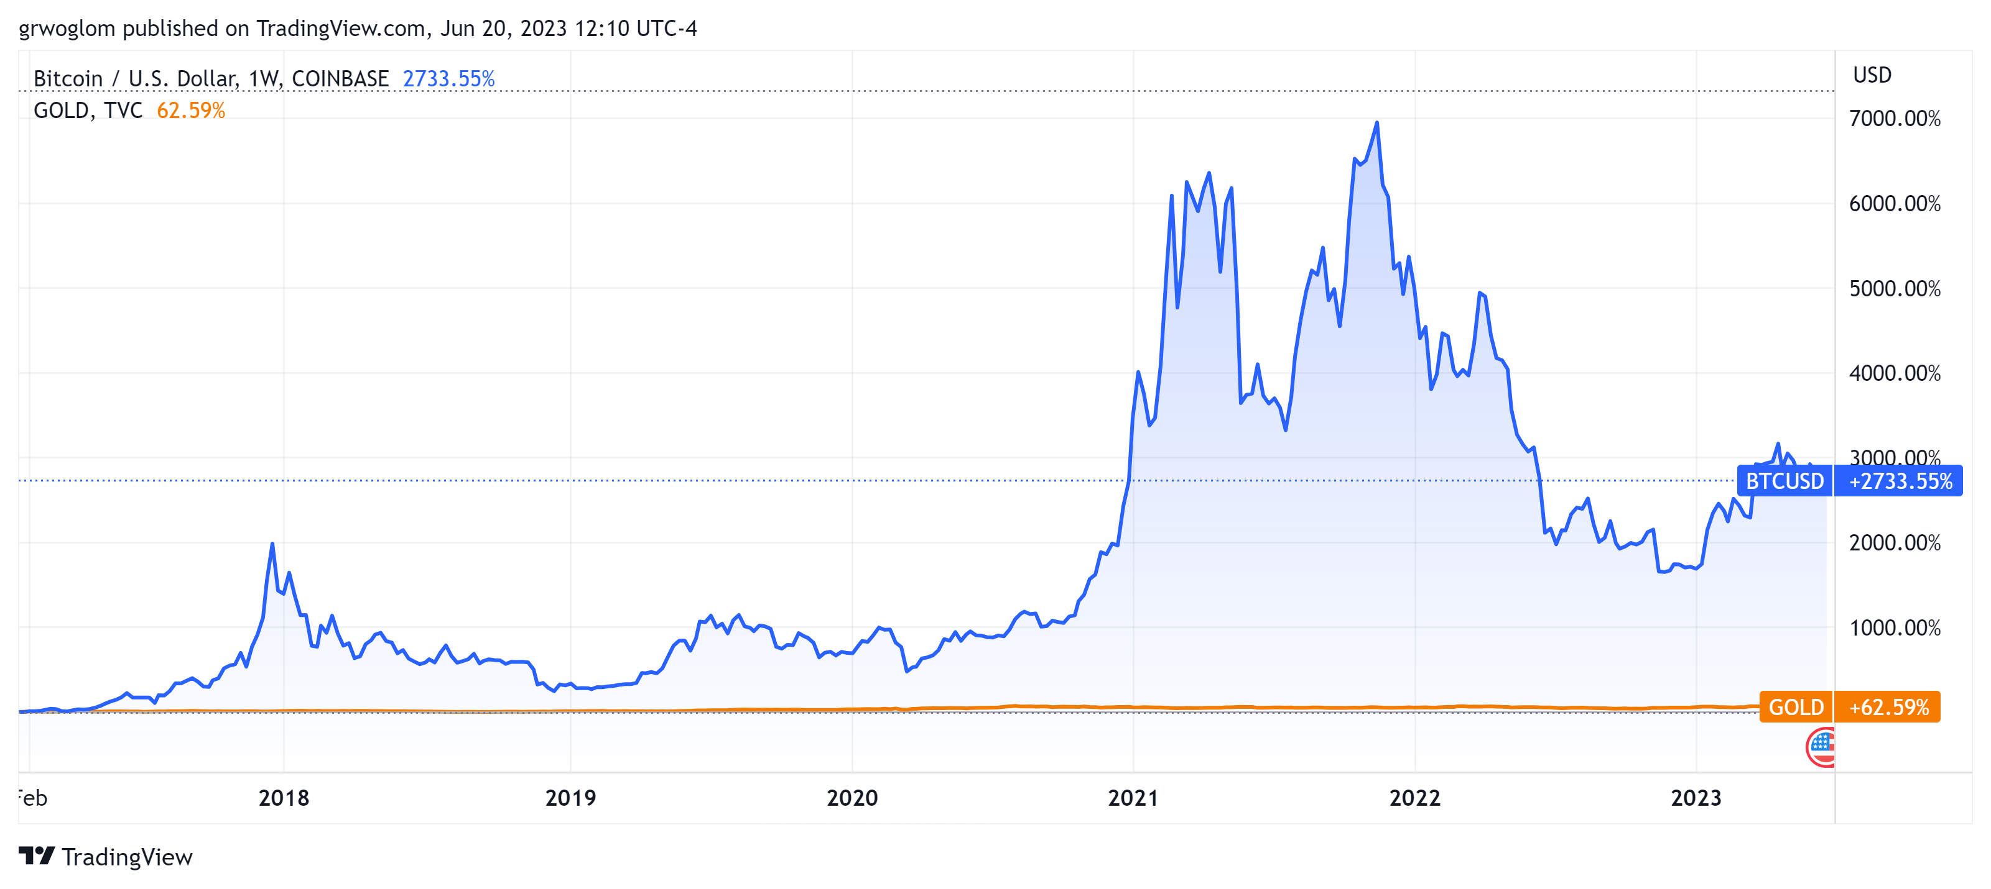
Bitcoins: What Is All the Excitement About?
Was
$27,060, at 12pm ET

Slide 11
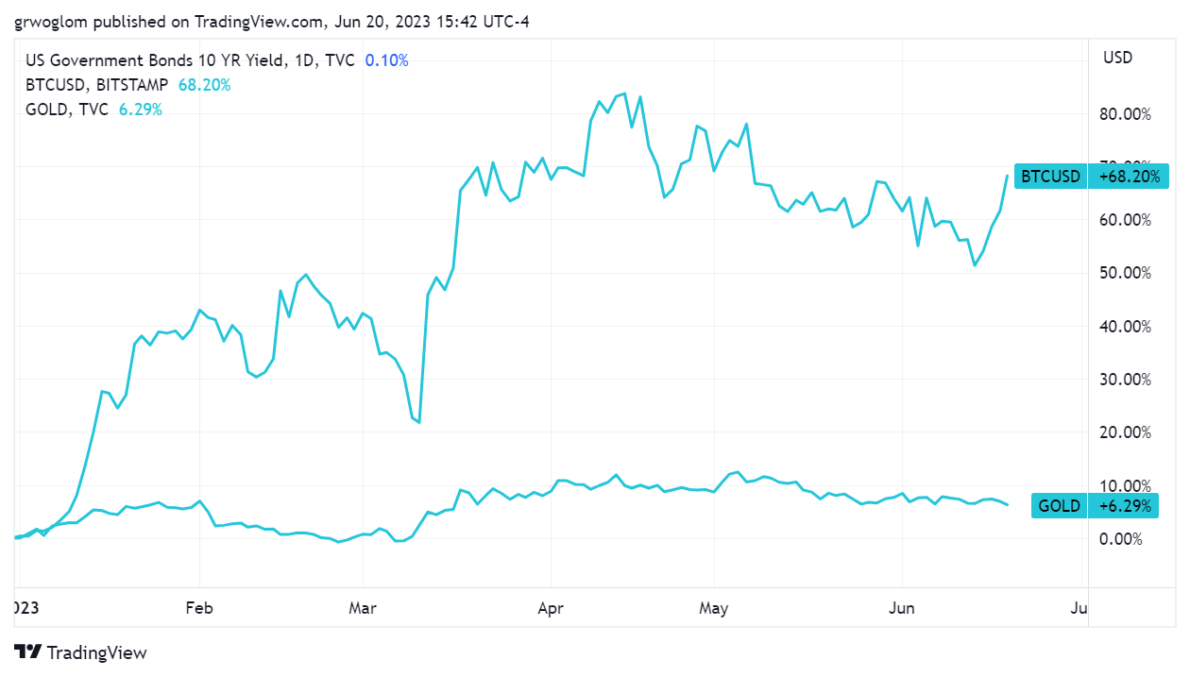
Bitcoin and Gold Volatility

Slide 12
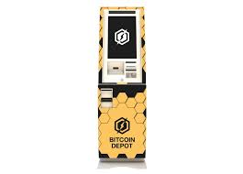
One of the Over 60,000 Bitcoin ATMs
Notes:
4201 Penn Ave, Pittsburgh, PA

Slide 13
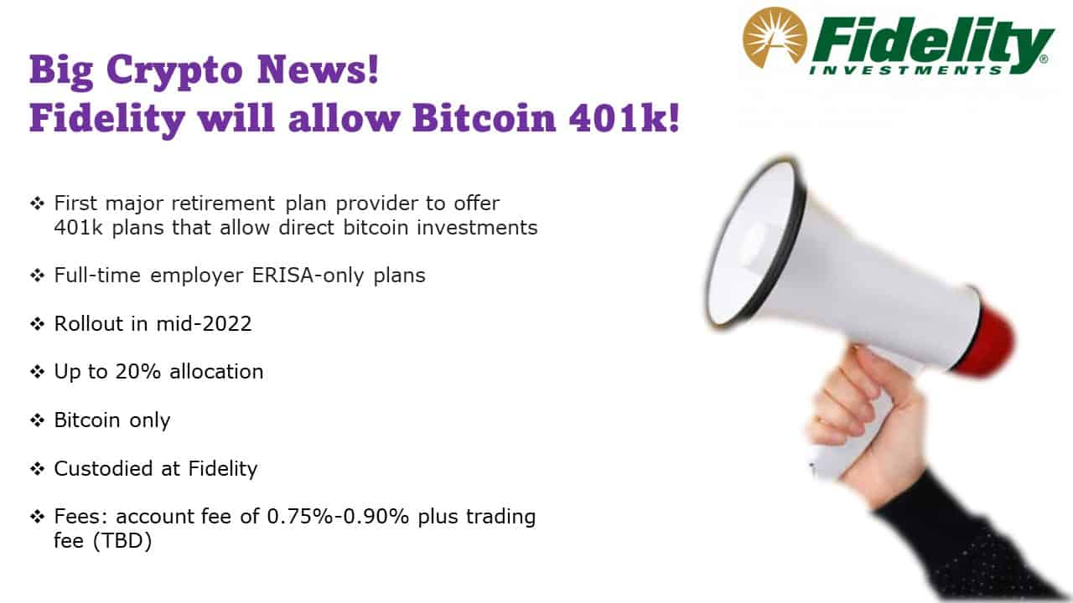
Give Me a Break?

Slide 14
An Origin Story Worthy of a Pulp Novel!
The Mysterious Satoshi Nakamoto:
  Lehman Brothers Bankruptcy, 9/2008
  Halloween 2008: a white paper is published on the Internet laying out the idea and design for Bitcoin. The author (or authors) used Satoshi Nakamoto as a pseudonym.
  January 2009: Satoshi releases the first version of the Bitcoin software.
  2009-2010: Satoshi releases new versions of the software and is actively involved in Internet Chatter about Bitcoin.
  April 2011: Satoshi ceases all known and/or verified communications.
To this date the identity or identities of Satoshi are unknown.
Notes:
Rick Santelli 2/19/2009 Teaparty Rant

Slide 15
The Possible Economic Role for Bitcoin
Satoshi’s Vision: “A purely peer-to-peer version of electronic cash [that] would allow online payments to be sent directly from one party to another without going through a financial institution.”
More, prosaically
Facilitate payments at lower costs with speed and security
  E.g., Credit Card Fees (3 percent).
  Merchant doesn’t get paid for at least 2 days.
  More importantly, cross-border transactions costs were $1.9 trillion in 2018.
  2019 Capital One hackers access personal information of 106 m users
Meet the needs of previously unbanked.
  Particularly a problem in the Developing World, but
  Fed estimates that 50 million US adults have little or no banking relationships.
Notes:
Satoshi, Bitcoin is “A purely peer-to-peer version of electronic cash [that] would allow online payments to be sent directly from one party to another without going through a financial institution.”
So, Natoshi’s goal was to improve money, in a way that did not depend banks or governments!

Slide 16
Facts about Cryptocurrencies (as of today, noon)
Bitcoin was the first and is the largest in terms of market cap (total value of all bitcoins) of about $525 billion.
Ethereum is in second place with a market cap of about $210 billion.
Presently, 13,000 different varieties with a total market cap of about $1.1 trillion (https://www.coingecko.com/en)
Market cap of domestically listed US companies is about $40 trillion.

Slide 17
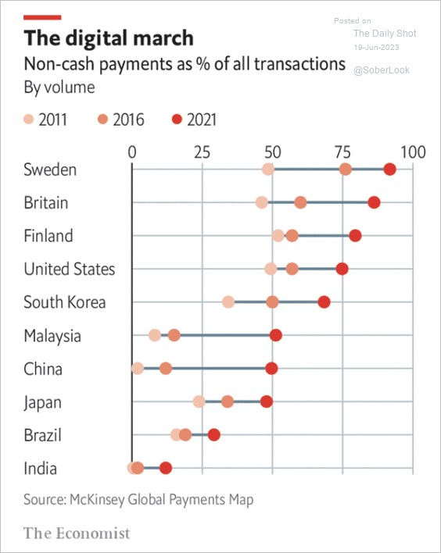
Payments Are Going Digital!
Presently, crypto currencies have little to do with these trends.
But, what about the future?

Slide 18
Underlying Technology of Bitcoin
Digital Token (exists only as data on a computer) whose ownership is cryptographically protected.
Distributed Ledger, Block Chain Technology.
Software protocol the provides a “consensus” mechanism on the validity of new transactions.
Payments based on trust, without a “trusted third party.” (i.e, a bank or the Fed).
Notes:
Define distributed Ledger

Slide 19
So, how does it work?
Jack, the owner of a bitcoin is given a public number or key and a private encrypted key.
Jack can trade his bitcoin with Jill by using Jill’s public key and verifying the transaction with his private key.
The new transaction is then posted on a a number of different computers and can be read by anyone.
The clearing of the transaction is done with public database or distributed ledger called a blockchain through a process know as bitcoin mining.
First, Bitcoin Miners gather about 3000 new transactions into a “block.”
The next step is to provide a decentralized mechanism to add the new block to the block chain and agree that the transactions are valid

Slide 20
Proof of Work: Bitcoin “Mining”
The miners’ competition involves generating long, random numbers (“hashing”) until one of the numbers fits a precise set of attributes.
Presently, miners produce on the order of 200 million trillion random numbers per second.
The winning miner then adds the new block to the previous block in the blockchain. The total process takes about 10 minutes
The incentive for miners is that the winner of the competition gets compensated with new bitcoins and transaction fees.
However, the miner will not get the reward unless other miners subsequently add new blocks to the first miner’s block.
In this way transactions are added to the chain via a “consensus” of miners.

Slide 21

Bitcoin Mine

Slide 22
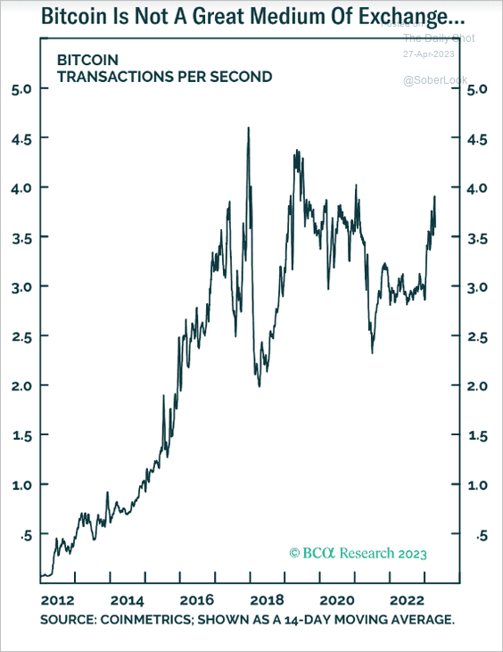
Question #1: Is Bitcoin serving an economic role
Bitcoin is not and cannot be widely used to make transactions
Scalability?
Price Instability.
Transactions costs
And, the network is costly
  Resources used in mining
  Environmental Costs
BIS, Annual Report 2018, Chapter V
Notes:
Presently, Bitcoin mining requires 150-200 terawatt-hours per year, more than Thailand with a carbon footprint of the Czech Republicenergy consumption (although less than is used in gold mining). (Note there are other consensus mechanisms that do not use as much energy.)
In addition, computer hardware quickly becomes obsolete and is dumped.

Slide 23
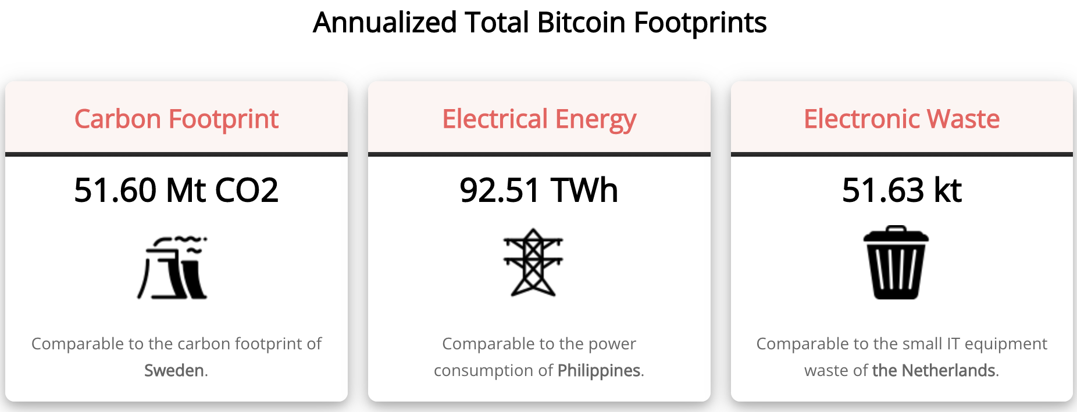
Bitcoin’s Environmental Impact
Source: https://digiconomist.net/bitcoin-energy-consumption

Slide 24
The Merge: Ethereum and Proof of Stake
Potential Block Creators place cryptocurrency in specialized wallets that are locked while they are acting as blockchain “validators” (as opposed to “miners”).
Validators are selected randomly, where the odds of being selected are proportional to the value of the currency “staked” in the wallet.
The rest of the process of validation is similar: transaction fees only paid if subsequent blocks are added, but!!
If an invalid block is discovered the staked deposit is forfeited.
Notes:
Merge occurred on September 15th

Slide 25
What Role Does Bitcoin (or Ether) Play?
For some it plays the same role as $100 bills: 32.8% of all bills in circulation (more than the number of $1 bills)
Illegal Activity
Notes:
Trading of banned goods; e.g, Silk Road
Ransomware Payments.
Money Laundering.
Tax Evasion

Slide 26
Illegal Activity and Bitcoinhe
Source: The 2023 Crypto Crime Report, Chainanalysis, 2/23
Notes:
Crypto Advocates: Less than 1% share of the total volume of transactions.

Slide 27
Kim Jong Un’s New Revenue Source
Source: The 2023 Crypto Crime Report, Chainanalysis, 2/23

Slide 28
But What about as an Financial Investment?
It is hard to argue with the fact that Bitcoin had provided outsized returns for many, albeit very volatile.
Financial Assets are Promises by the Issuer
The “fundamental value” of a financial assets is the value of those promises based on the time value of money and the risk that the promises will not be kept.
What does Bitcoin promise?
Notes:
Promised future payments such as dividends for stocks or coupon payments for bonds.
For currencies, promise of future use in exchange with stable values.
Bitcoin only promises the possibility of capital gains, but not based on future payments.

Slide 29
How Do Economist Think About Investments?
Good Starting Place
“In the short term the stock market behaves like a voting machine, but in the long term it acts like a weighing machine.”
What is being weighed is prospective payments from the security, or other intrinsic value, i.e. its fundamental value.
Bitcoin?
Notes:
Warren Buffet paraphrasing Benjamin Graham. Payments mean dividends or coupon payments. Even, gold has some intrinsic value as the ultimate insuarbne

Slide 30
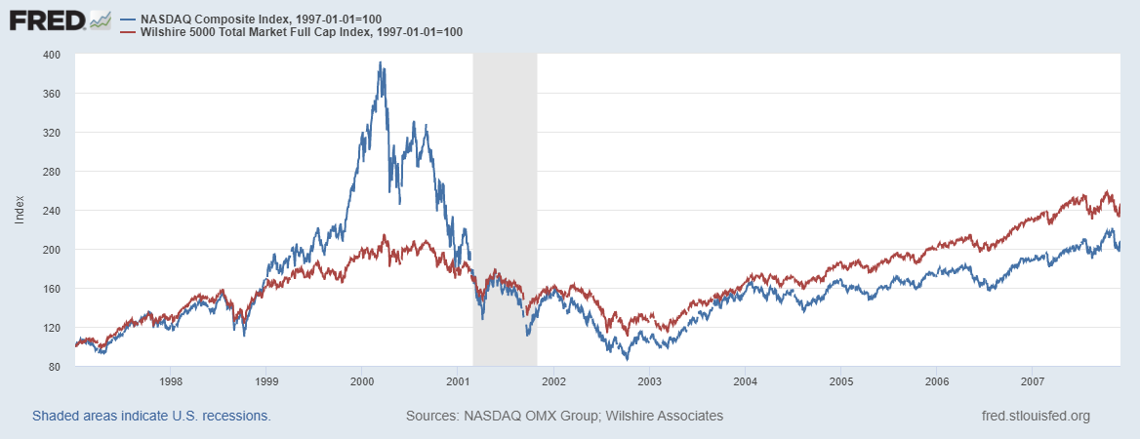

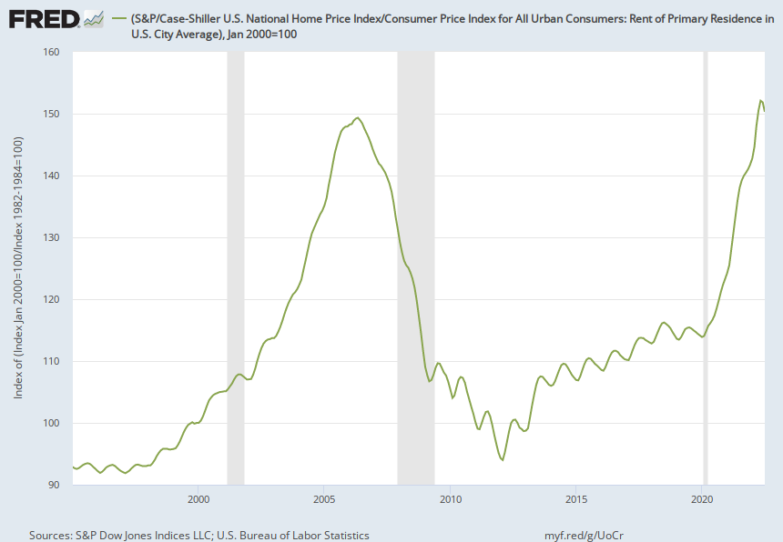
Does Voting Ever Get it “Wrong?”

Slide 31
Question #2: The Value of the New Technology?
Don’t Throw the baby out with the bathwater!
The value cryptographically protected digital-tokens is nuanced:
Blockchain technologies have significant promise some of which is already being realized.
  Private blockchains, Walmart and its produce suppliers
  Public Blockchains, Ethereum and smart contracts
See: Mehta N,. Agashe A., P. Detroja Blockchain Bubble or Revolution, 2021
Notes:
Cryptographic protection is a tougher call and depends on your views of privacy rights, as well as what information is being kept private (e.g., medical records versus financial transactions) Supply Chains (Walmart IBM)
Smart Contracts (Xbox royalties)

Slide 32
Smart Contracts on the Blockchain
A Smart Contract is a computer code that resides on the block chain and is executed based on incoming information.
Example, Parametric Hurricane Insurance via the Blockchain:
  Computer program on Ethereum continuously monitors Charleston Executive Airport wind speed for 1 year.
  If the windspeed is greater than 150 miles per hour, immediately transfers 100 bitcoin to the Seabrook Island Property Association.
  If the windspeed is less than 150 miles per hour, but more than 125 miles per hour, immediately transfers 75 bitcoin; etc.
Smart Contracts are Automatic, Immediate, Irreversible and Uncontestable.

Slide 33
DeFi and Smart Contracts
Broad Category of Decentralized Financial Services
  Crypto exchanges, online lending platforms, crypto derivatives, insurance, startup finance, etc.
Smart Contracts are executed mostly on the Ethereum blockchain. No brokers, financial intermediaries, traders, and little regulation.
I personally have not seen the “killer application” of DeFi
Note in my insurance example, that bitcoin isn’t a great means of payment because of price volatility.
Notes:
Recently, these numbers have come down

Slide 34
Clearly, Not Good News for Defi
Source: The 2023 Crypto Crime Report, Chainanalysis, 2/23

Slide 35
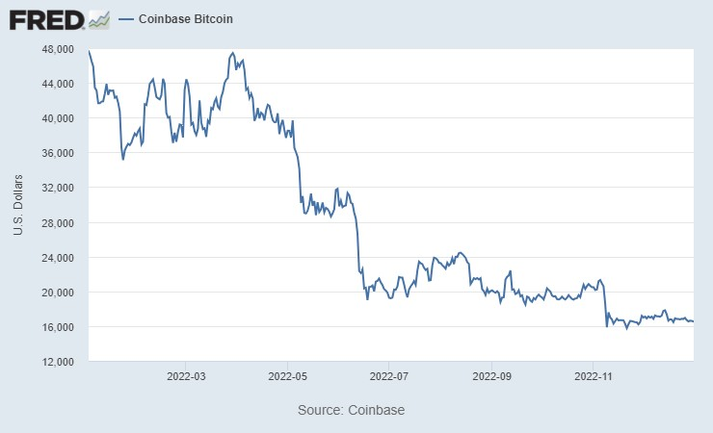
Enter Tether: Reserve Backed (?) Stablecoin
“The Coin That Could Wreck Crypto” (NYTIMES, 6/17/2022): “In 2021, New York’s attorney general fined Tether $18.5 million and said the company had lied about its reserves, calling it ‘a stablecoin without stability.’”
Market cap of $68 billion; daily volume of $50 billion.
What could go wrong?
May 12 2022: Tether “Breaks the Buck”
Notes:
WSJ, Headline, 8/11/2021, “Poly Network Hackers Steal More Than $600 Million in Cryptocurrency” Bloomberg 7/27/2021: “Tether and the Facebook Inc.-backed Diem token were a main focus of a recent meeting of U.S. regulators held on the financial risks posed by stablecoins.
Facebook NOVI wallets for holding Pax dollars ($1.1 billion in market cap)

Slide 36
“Clean Up the Mess on Aisle 3”
Gary Gensler, Chair of the SEC quote from a WP interview.
Rostin Benham, Chair of the CFTC
Janet Yellen at Treasury.
They will act, but they would need Congressional legislation, too: Cash markets in cryptocurrencies are viewed as commodities and are unregulated
Notes:
Paper on CBDC

Slide 37
Sam Bankman-Fried & FTX
In August, Fortune compared the 30-yr old to Warren Buffet.
Helped save BlockFi and other crypto firms in May 2022.
Mid November $32b firm declares bankruptcy; SBF’s net worth goes from $16 billion to 0.
Misused customer funds to prop up his investment firm Alameda Research.
Regulation is needed!

Slide 38
Another sad tale of hubris
But wait . . .
“John J. Ray III is the new CEO of FTX.
In his eyes, he has been handed a complete mess.
‘Never in my career have I seen such a complete failure of corporate controls and such a complete absence of trustworthy financial information as occurred here,’ he said in a court filing.”

Slide 39
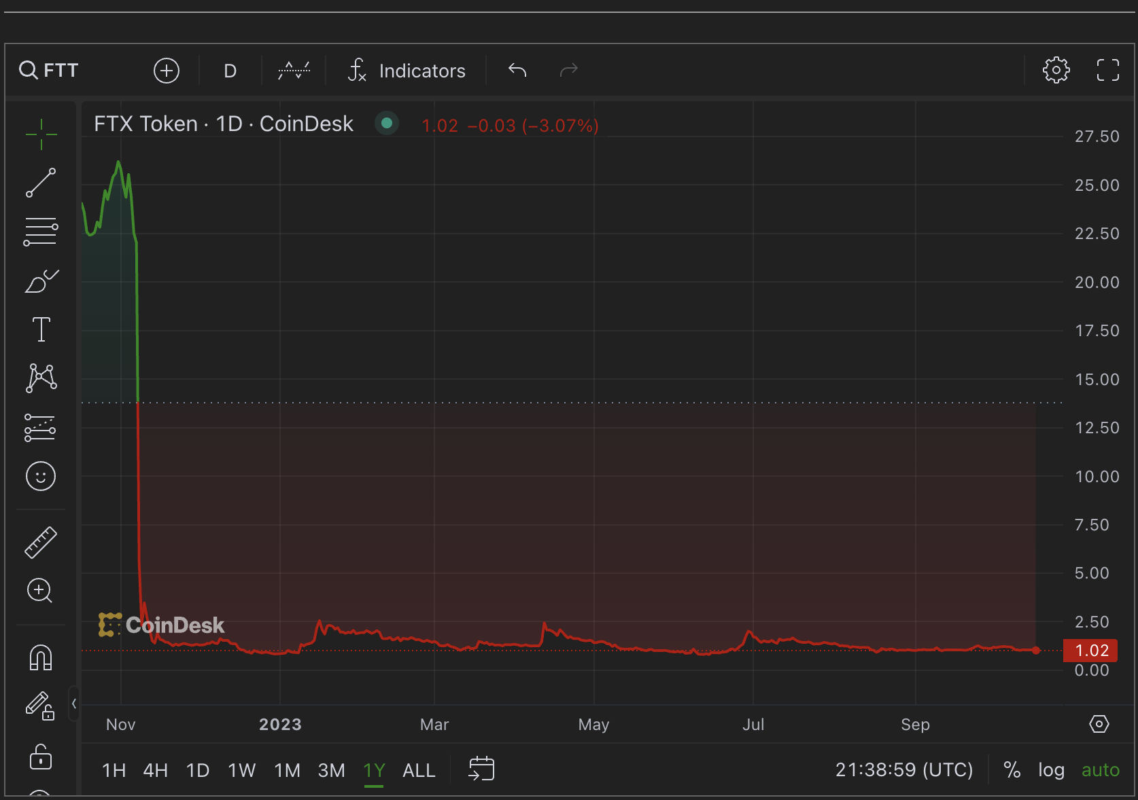
FT Governance token of FTX

Slide 40
Ge Gemini Exchange Offered an Earn Product
“One of the Earn investors was Complainant No. 1, a 73-year-old mother, grandmother, and resident of the State of New York. She and her husband, who are both retired, invested their life savings of over $199,000 in Earn because they believed Gemini’s marketing statements that Gemini was a safe and secure choice. Complainant No. 1 had hoped to use this money to pay for her grandchild’s education. Outside of her Earn investment, she and her husband have little savings.”

Slide 41
Believe it or not?
“According to the NYAG, Gemini knew their exposure to Genesis was high risk, but continued to promote the Gemini Earn lending product to retail customers as a safe way to earn profits on their crypto holdings. According to the NYAG, Gemini at one point revised its internal evaluation of Genesis’ creditworthiness to “junk grade”, some of their own risk personnel withdrew their own funds from the Gemini lending program, and one exec compared Genesis’ condition to the Lehman Brothers shortly before its collapse — but no communication was ever made to customers to inform them that the product had become riskier, nor did Gemini ever really stop working with Genesis (despite gestures at doing so a month or two before Genesis ultimately halted withdrawals).”

Slide 42
Who should know what?
“Another Earn investor, Complainant No. 2, is a 56-year-old resident of the State of New York. Complainant No. 2 invested approximately $20,500 in Earn, virtually all his savings. Complainant No. 2 chose Earn because he researched the product and came to believe, based on Gemini’s statements, that Earn was more secure than other interest-bearing cryptocurrency investments.”

Slide 43
What is Good Regulation?
The Principles Are Easy;
  Eliminate fraud, abuse and manipulation.
  Do not let markets be dominated by a small number of powerful firms.
  Allow startups with new innovations to displace incumbent firms.
  Minimize risk of a financial crisis.
Legislation and Implementation: Hasn’t Been Easy

Slide 44
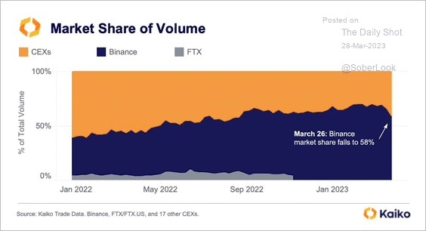
After SBF: Binance
Matt Levine, Bloomberg, “A decent rule of thumb is that all cryptocurrency exchanges are doing crimes, and if you’re lucky your exchange is doing only process crimes.
Market Share of Coinbase, 5%. But, 60% share of US consumer.

Slide 45
Gary Gensler Has Seen Enough
Gary Gensler quotes from SEC Press Releases announcing enforcement actions against Binance (6/5) and Coinbase (6/6):
“…Binance entities engaged in an extensive web of deception, conflicts of interest, lack of disclosure,…”
“We allege that Coinbase, despite being subject to the securities laws, commingled and unlawfully offered exchange, broker-dealer, and clearinghouse functions,…”

Slide 46
Can We Turn Our Back on Digital Money?
The Bank for International Settlement (BIS) and a number of central banks are exploring how the development of Central Bank Digital Currency (CBDC) “contribute to an open, safe and competitive monetary environment that supports innovation and serves the public interest.”
CBDC would be a government-backed stable coin
  Retail vs wholesale
  Blockchain
  Privacy
Source of quotes, BIS Annual Report 2021

Slide 47
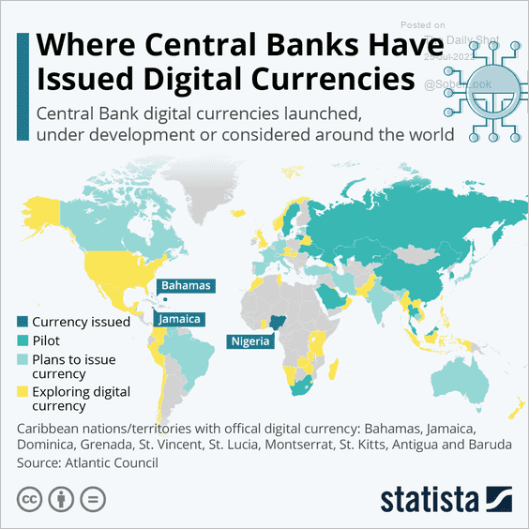
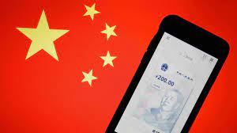
The Devil Is In the Details
Many countries as diverse as Sweden, Ecuador and China have begun experiments with CBDCs.
Where’s the Fed?
Source: E. Prasad, The Future of Money
Notes:
MIT Boston Fed experiment. But pretty conservative vision. CBDC offered to consumers through insured institutions, i.e., banks. Electronic cash like checks.

Slide 48




Who should design our payment system?
Notes:
Vitalek Buterin, age 27 cofounder of Ethereum at age 20

Slide 49
Glossary
Traditional Money is currency plus bank checking accounts.
Currency is paper and coin issued by the government. Currency is legal tender and must be accepted for all debts. Transactions using currency are immediate and final (can’t be undone without the agreement of both parties.)
Digital Payments are used for purchases where no physical money is exchanged. Examples include many online banking payments, credit card payments, PayPal.
Digital Currency or Virtual currency is a form of money that exists solely in digital form, such as a digital token (i.e., as data on a computer). Examples: cryptocurrencies, central bank digital currencies and virtual currencies used in online gaming.
Cryptographic identity protection assigns people two account numbers, or keys, one public and one private. Public record keeping is done using the public key and transactions are authorized using the private key.
Cryptocurrency is a digital currency where the owner’s identity is protected using cryptographic encryption and where record keeping is done with a public blockchain, e.g., Bitcoin.
Stablecoin is a cryptocurrency with a stable value of $1, somewhat like a money market mutual fund.

Slide 50
Glossary (Cont.)
Distributed ledger is a database for recording transactions or other information, where the information or ledger is shared on a network of many computers simultaneously.
Blockchains are distributed ledgers where new transactions (new blocks) are added to the chain sequentially when a consensus of the network agrees that the transactions are valid.
Decentralized Finance (DeFi) is peer-to-peer financial activity conducted through public blockchains and smart contracts.
Smart Contracts are computer programs that execute automatically based on external conditions. Example, travel insurance that pays off automatically when a flight is cancelled.
Central Bank Digital Currency (CBDC) is a digital currency issued by a central bank. Different central banks are experimenting with various forms of CBDCs, including some using blockchain technology, electronic wallets and cryptography.

Slide 51
Resources to Learn More
N. Mehta, et.al. Blockchain Bubble or Revolution
E Prasad, The Future of Money (https://youtu.be/o3NuHb7V1IA)
Presidential Working Group on Financial Markets, 11/1/21 (https://home.treasury.gov/system/files/136/StableCoinReport_Nov1_508.pdf)
Federal Reserve White paper
(https://www.federalreserve.gov/publications/files/money-and-payments-20220120.pdf)
Executive Order: https://www.whitehouse.gov/briefing-room/statements-releases/2022/03/09/fact-sheet-president-biden-to-sign-executive-order-on-ensuring-responsible-innovation-in-digital-assets/

Slide 52
Economic Needs Don’t Go Unmet for Long
Meeting the Banking Needs in Less Developed Countries: Mobile Money.
M-Pesa:
  Started in Kenya in 2007 and now available in 10 countries.
  Buy M-Pesa credits from “agents” (local shop) which can be transferred to others with an M-Pesa account via cellphone.
  96 percent of Kenyan households have a mobile account
Grameen Foundation:
Making Cash Digital is the Key to Possibility
When Poor Women Control their own money, it no longer controls them.

